Slide 1
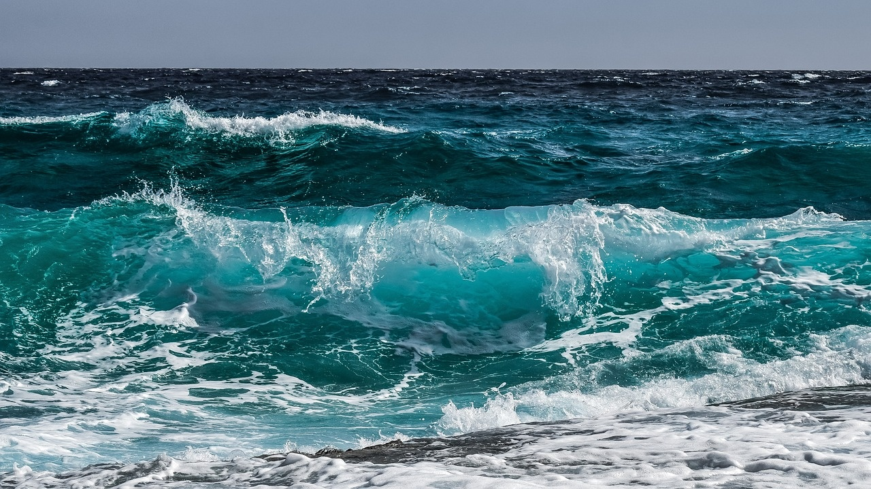
Diving into the Abyss: A Journey through Oceanic Marvels
From Marine Life Diversity to Climate Change Impacts

