Slide 1
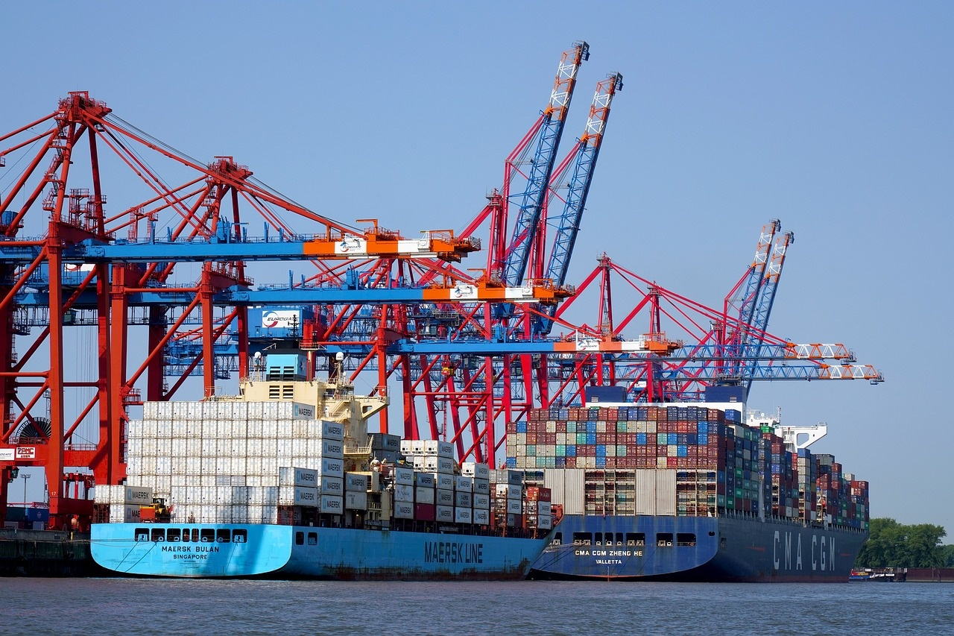
Navigating the Evolving Global Food Supply Chain
Exploring Challenges, Innovations, and Sustainability for Future Resilience

