Slide 1
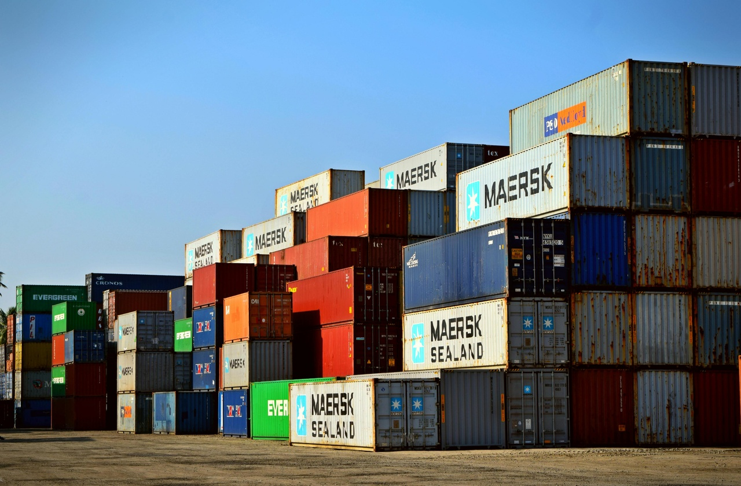

Challenges in Supply Chain Management
Globalization
Demand Volatility
Managing diverse regulations and customs across borders.
Increased complexity in logistics and documentation.
Fluctuating consumer preferences and market trends.
Strain on forecasting accuracy and inventory management.
Sustainability
Supply Chain Disruptions
Balancing environmental concerns with operational efficiency.
Pressure to reduce carbon footprint and waste throughout the supply chain.
Natural disasters, political unrest, and pandemics.
Impact on production, transportation, and overall supply chain resilience.
Revolutionizing the Global Food Supply Chain

