Slide 1
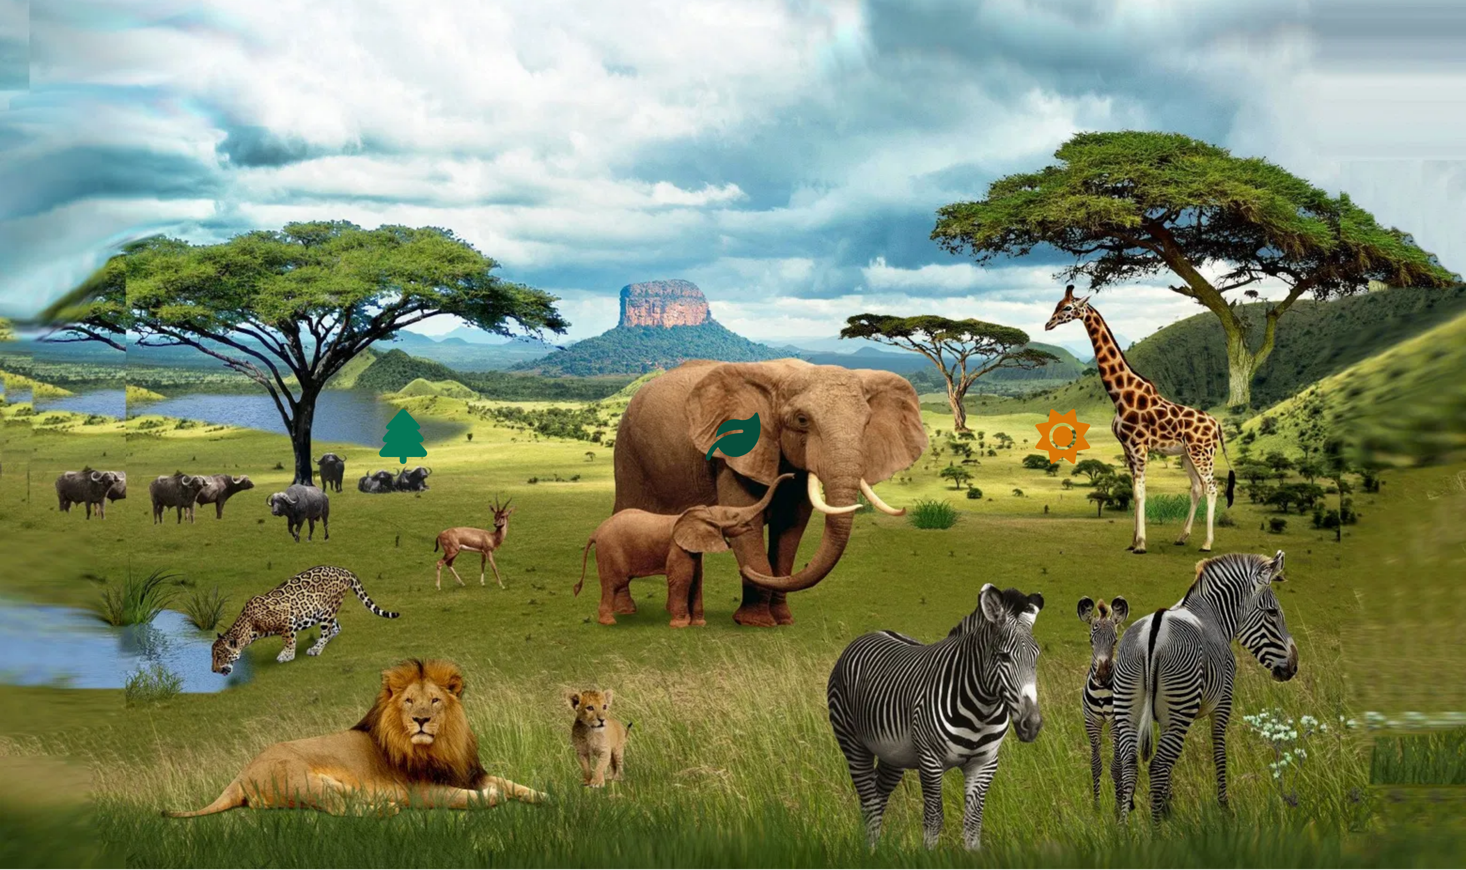
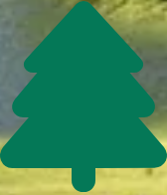
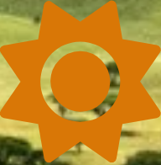
Wildlife in Africa
A Journey Through Earth's Most Diverse Ecosystems
Savanna
Rainforest
Desert
Home to the iconic Big Five and the Great Migration
The Congo Basin: Earth's second-largest tropical forest
Remarkable adaptations in extreme environments
Africa's diverse landscapes support an extraordinary variety of wildlife,
showcasing nature's remarkable adaptability and the importance of conservation.

Slide 2
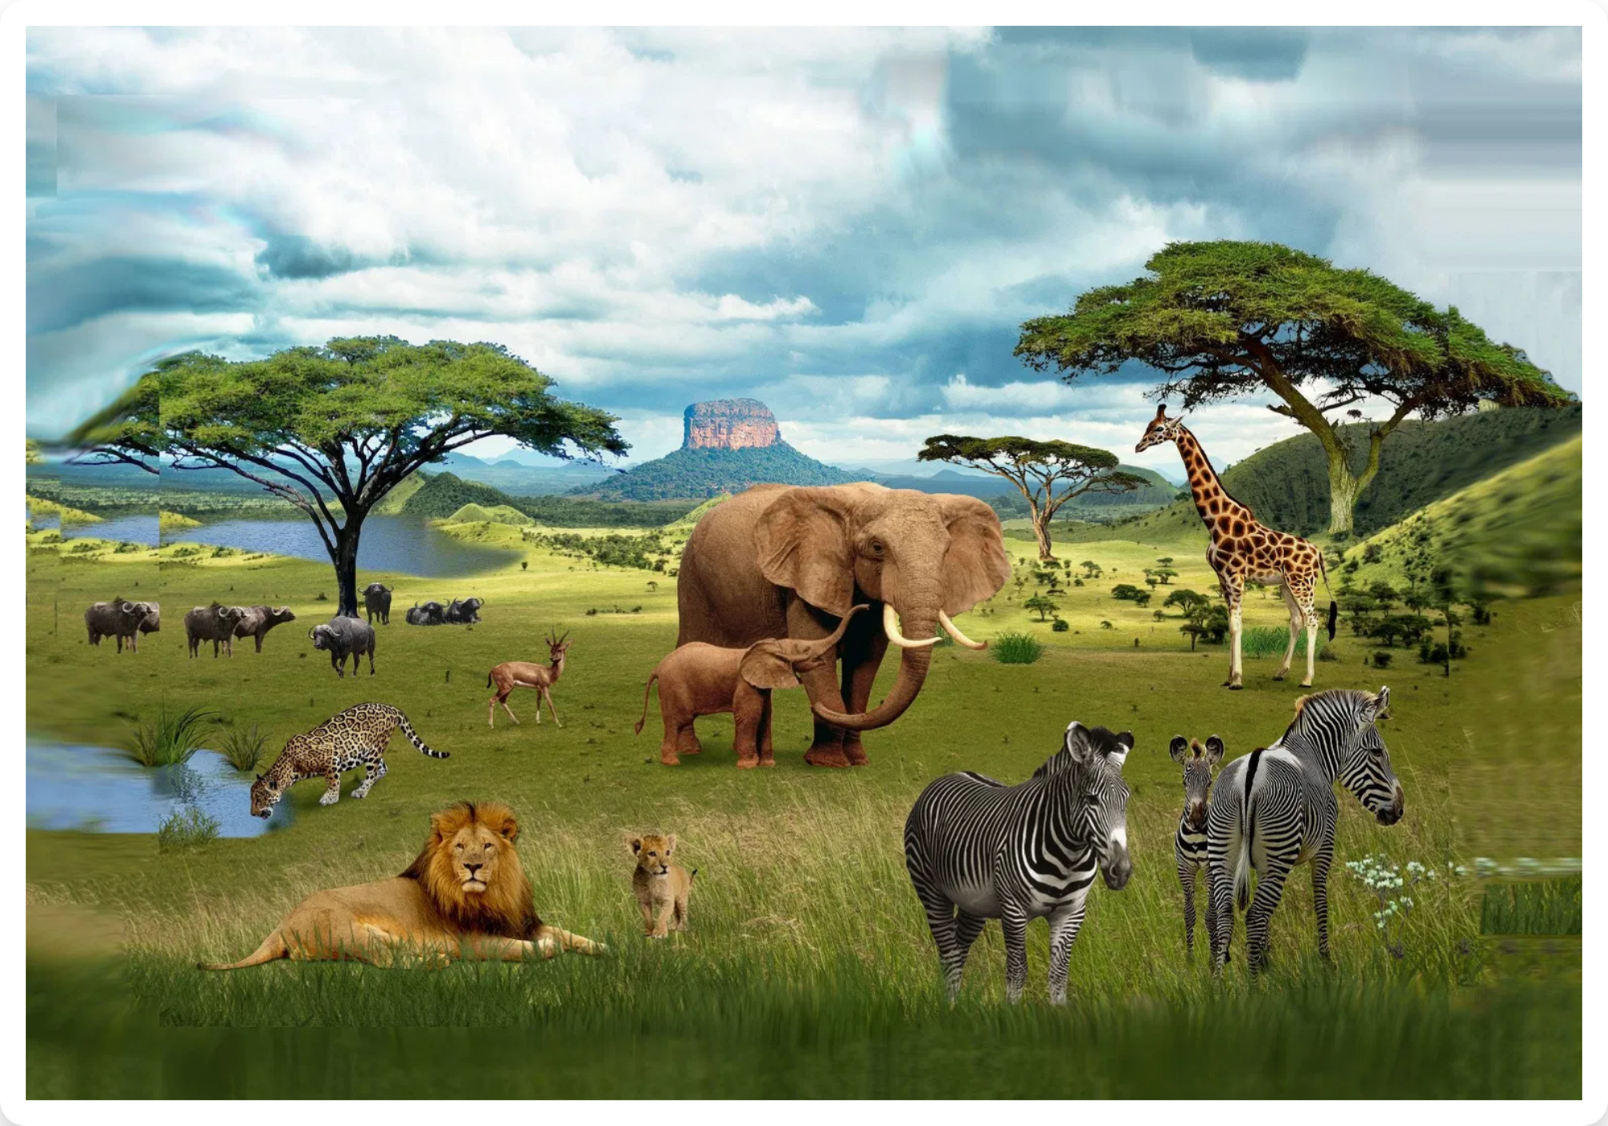
The African Savanna
Characteristics:
Scattered trees and continuous grass understory
Hot climate with distinct wet and dry seasons
Annual rainfall: 50-150 cm (20-59 inches)
Dry season: 2-11 months
Temperatures: 10-30°C (50-86°F)
Distribution:
Covers large areas of eastern and southern Africa, transitioning between forests and deserts
Types of Savannas
Ecological Significance:
Supports the greatest diversity of large mammals on Earth and hosts spectacular wildlife migrations
Wet Savanna
Dry Savanna
Thornbush
3-5 month dry season
5-7 month dry season
Longest dry season

Slide 3
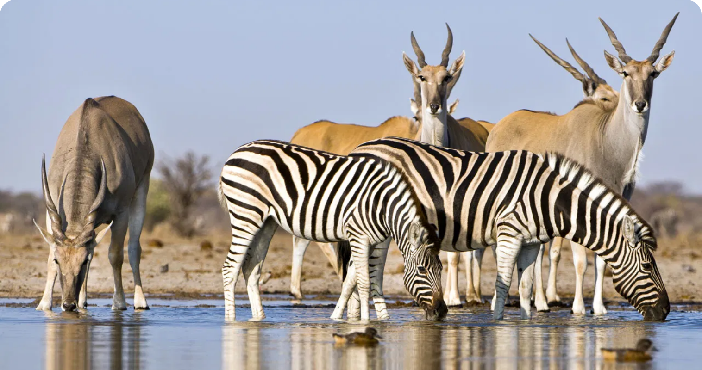
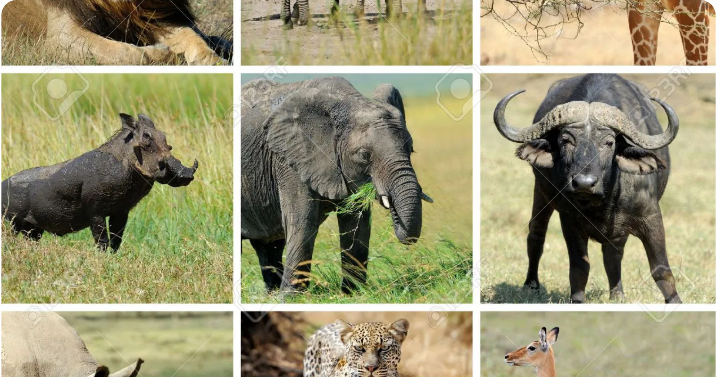
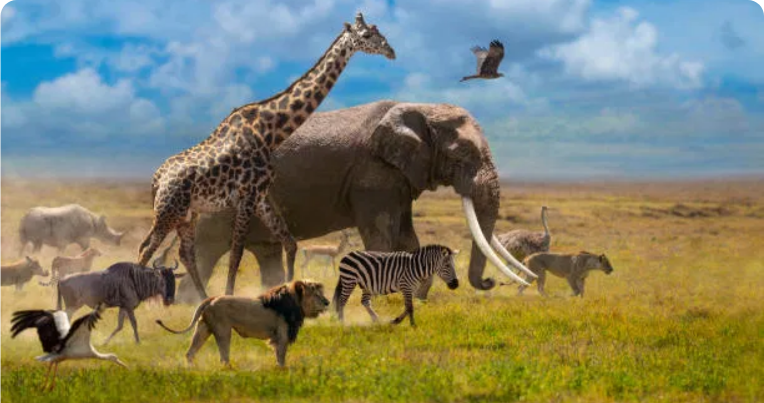
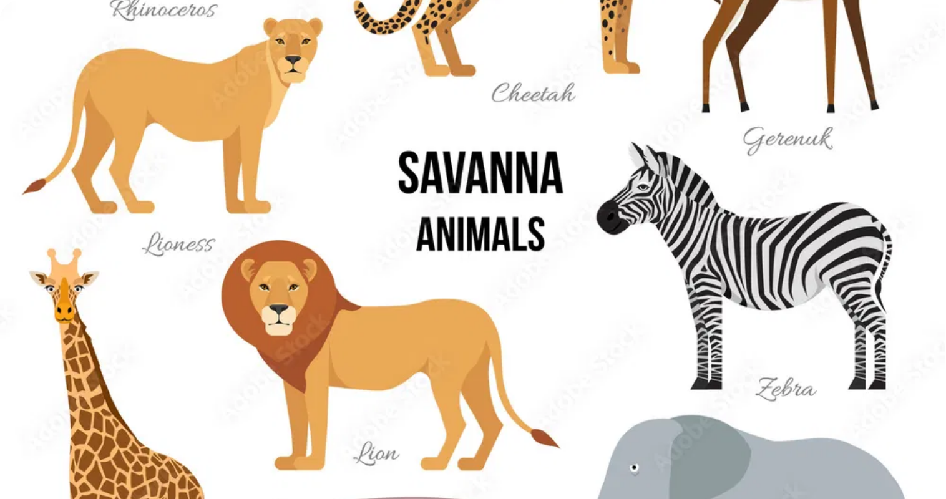
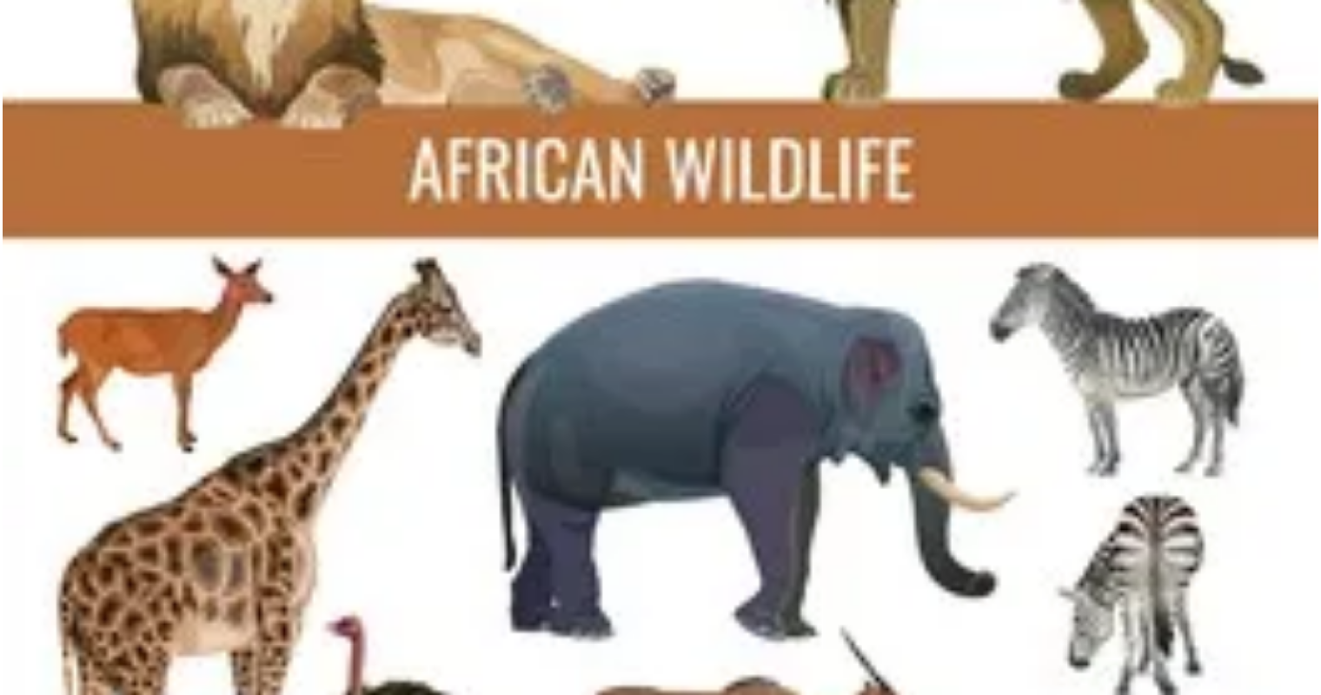
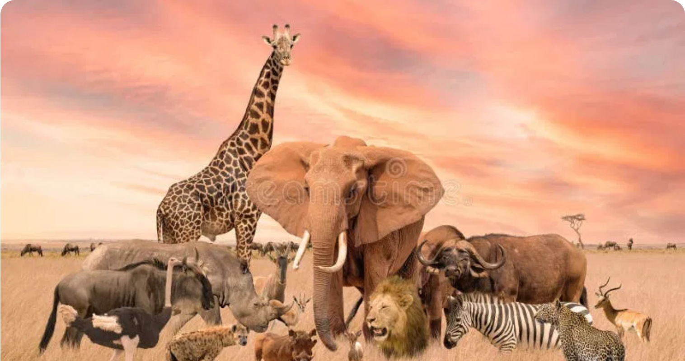
Iconic Savanna Species
African Elephants
Lions
Zebras
Largest land mammals on Earth
Africa's apex predator
Unique stripe patterns for identification
Highly social with complex family structures
Live in social groups called prides
Stripes help deter biting insects
Can consume 300 lbs of vegetation daily
Females do most of the hunting
Live in family groups or bachelor herds
Vulnerable conservation status
Vulnerable conservation status
Key participants in the Great Migration
Giraffes
Wildebeest
Cheetahs
World's tallest land animal
Main species in the Great Migration
Fastest land animal (70 mph/112 kph)
Feed on leaves other herbivores can't reach
Travel up to 1,000 miles annually
Specialized for high-speed hunting
Unique spot patterns like fingerprints
Migrate in herds of over 1 million
Non-retractable claws for traction
Vulnerable conservation status
Calves can run within minutes of birth
Vulnerable conservation status

Slide 4
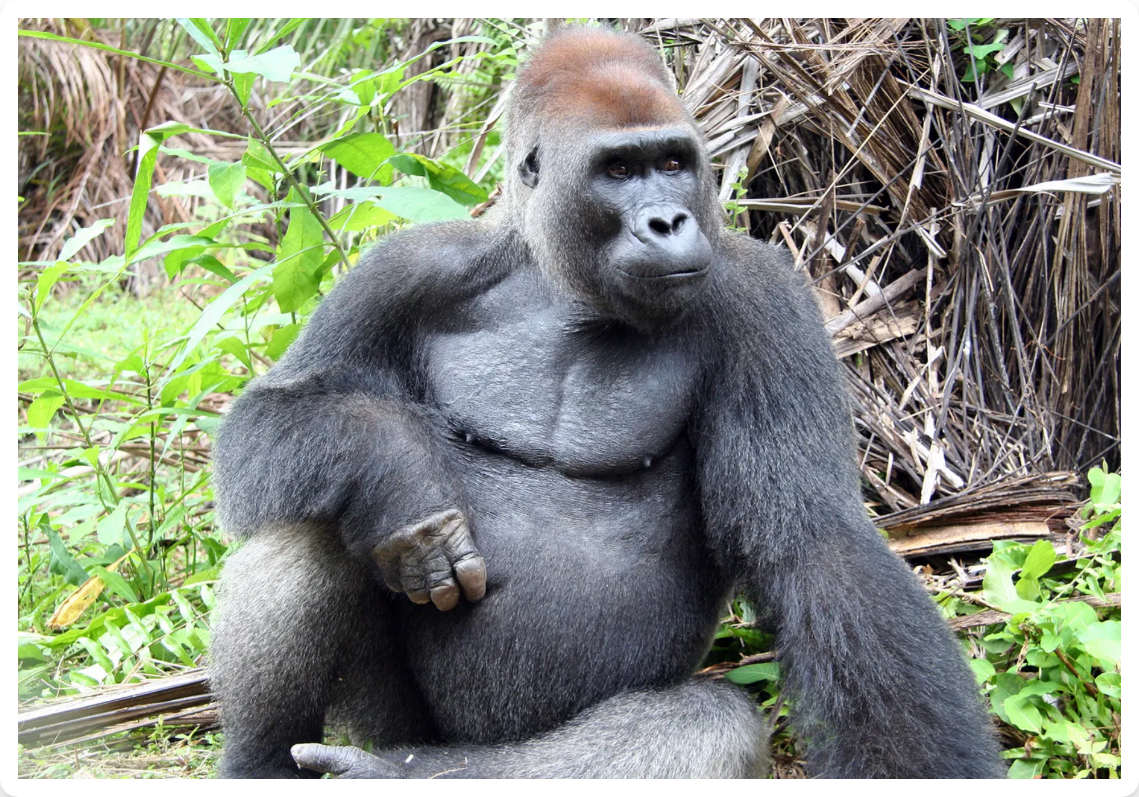
The Congo Basin Rainforest
Size & Significance:
World's second-largest tropical forest (500 million acres)
Spans six countries: Cameroon, Central African Republic, Democratic Republic of Congo, Republic of Congo, Equatorial Guinea, and Gabon
Contains 70% of Africa's tropical forests
Planet's largest remaining tropical carbon sink
Biodiversity:
Home to one in five of Earth's living species, including:
400+ mammal species
Ecological Importance
1,000+ bird species
700+ fish species
10,000+ plant species (30% endemic)
Climate Regulation
Water Cycle
Biodiversity
Absorbs CO₂ & releases oxygen
Maintains rainfall patterns
Supports countless species

Slide 5
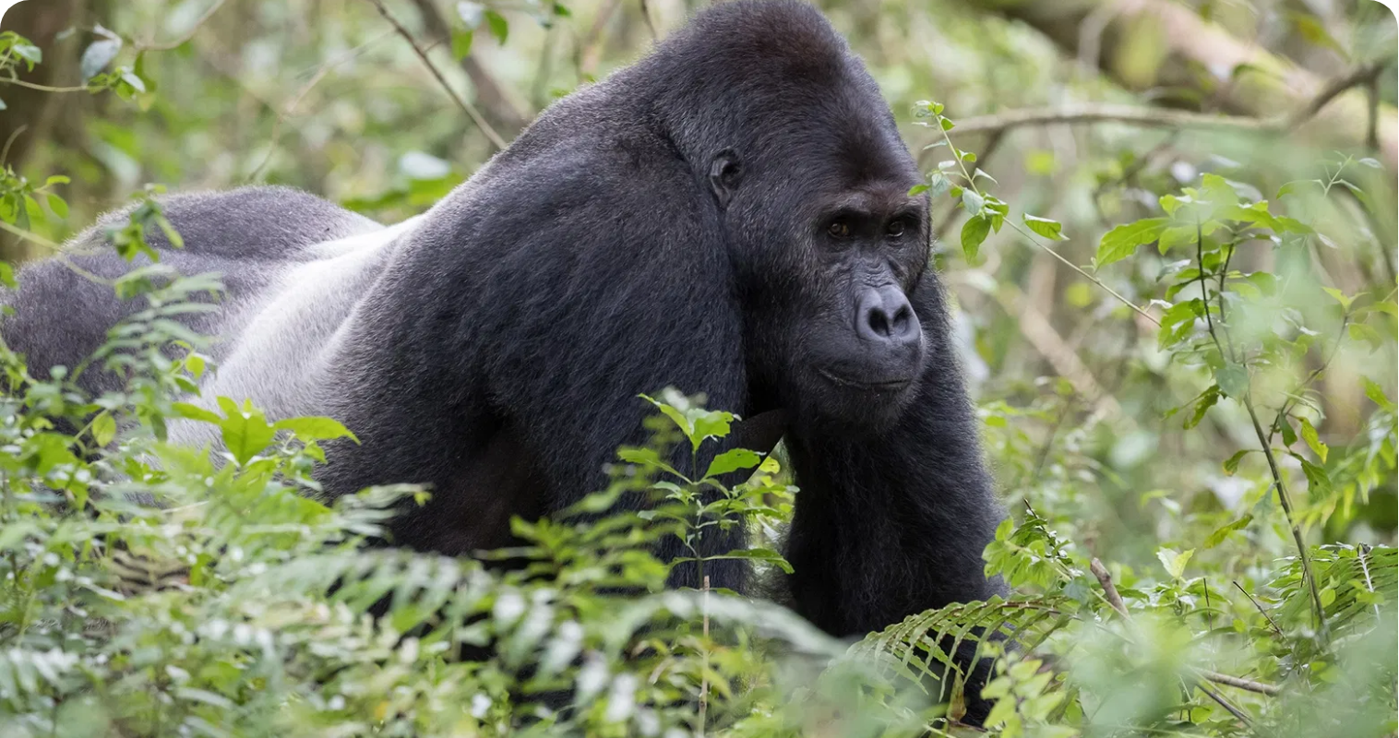
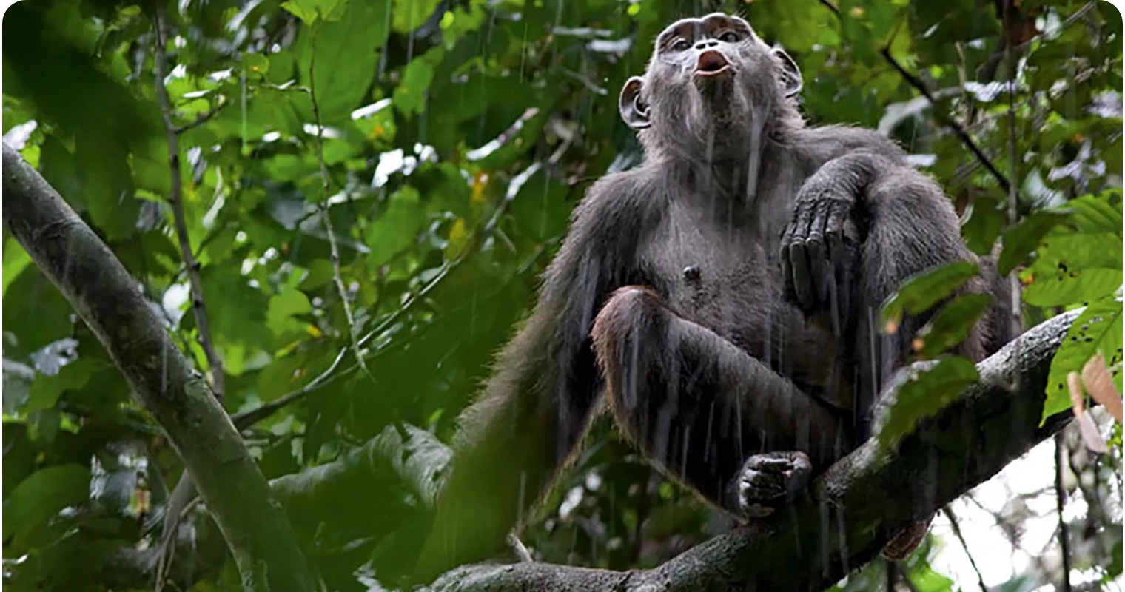
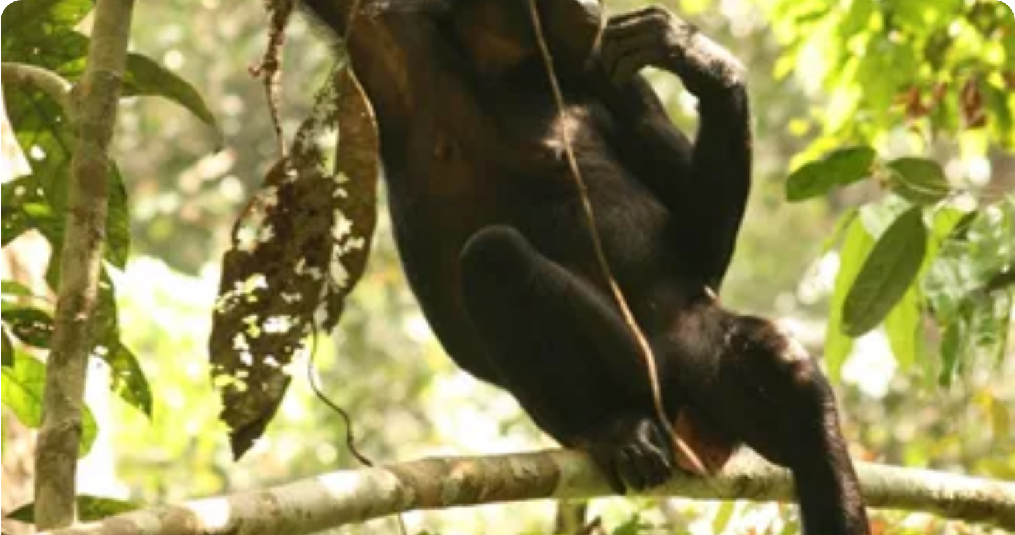
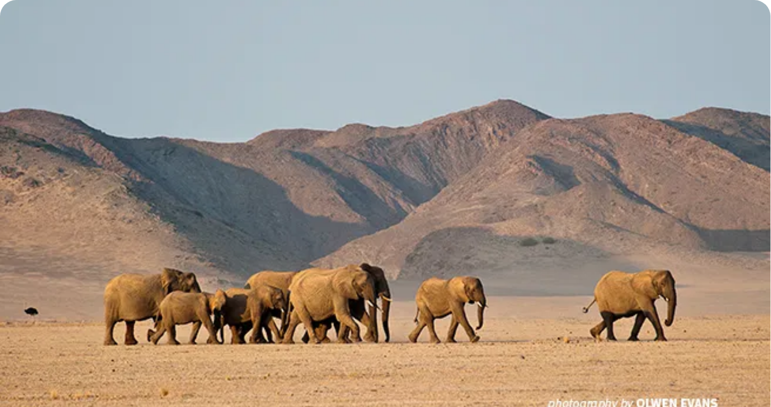
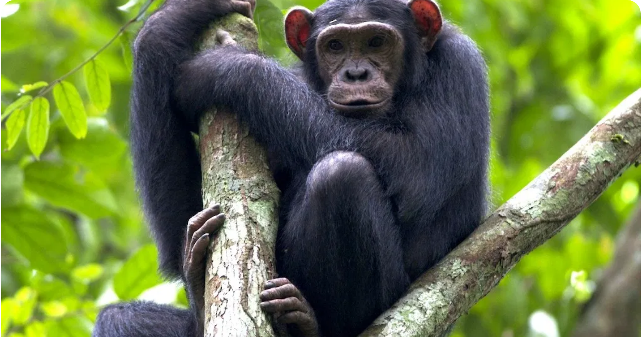
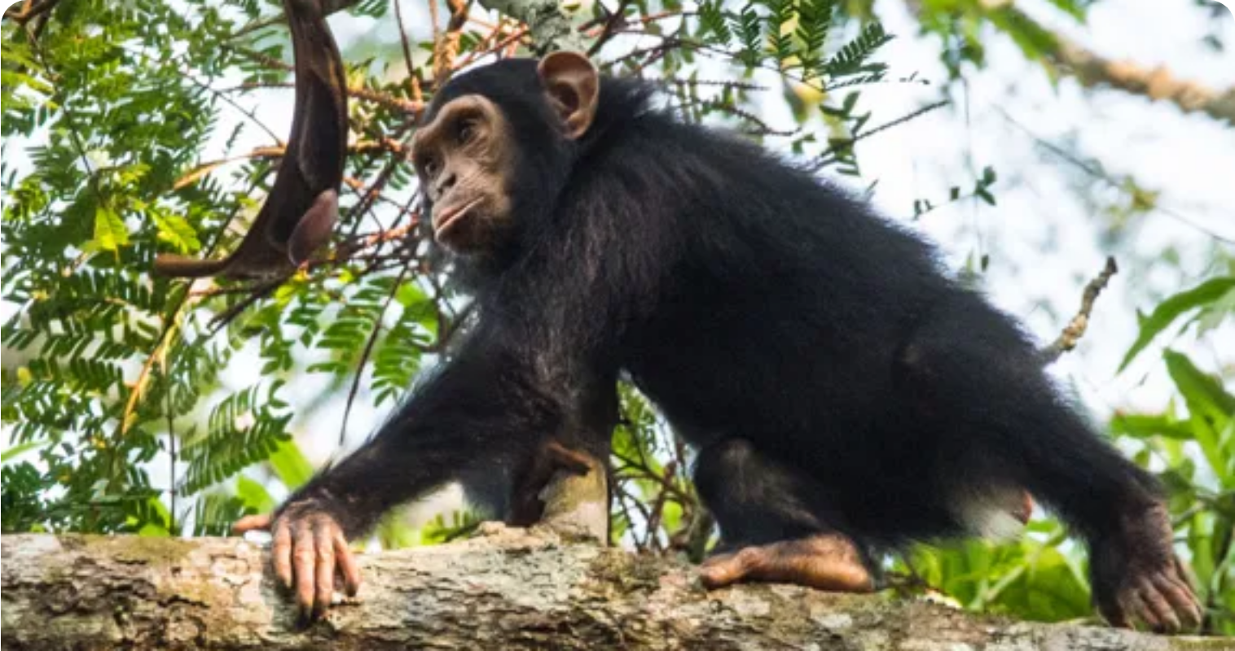
Rainforest Wildlife
Gorillas
Chimpanzees
Bonobos
Largest living primates
Share 98.6% DNA with humans
Endemic to DRC, south of Congo River
Highly intelligent and social
Use tools and have complex social structures
Matriarchal social structure
Primarily herbivorous diet
Omnivorous diet includes fruits and meat
Known as "forest gardeners" - seed dispersers
Critically endangered status
Endangered conservation status
Endangered conservation status
Forest Elephants
Okapi
African Grey Parrot
Smaller than savanna elephants
Known as the "forest giraffe"
One of the most intelligent bird species
Straighter, downward-pointing tusks
Endemic to northeastern DRC
Can mimic human speech and sounds
Critical seed dispersers for rainforest
Zebra-like stripes on hindquarters
Important seed dispersers
Critically endangered status
Endangered conservation status
Endangered due to pet trade

Slide 6
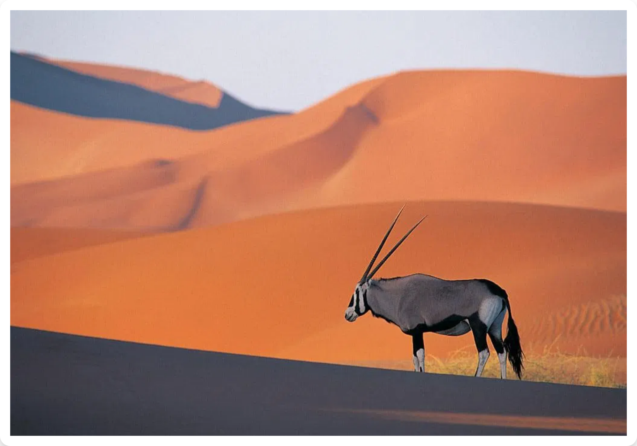
African Desert Ecosystems
Major African Deserts:
Sahara Desert:
World's largest hot desert, spanning 3.6 million square miles across North Africa
Namib Desert:
One of the oldest deserts, along southwestern Africa's Atlantic coast
Kalahari Desert:
Semi-arid sandy savanna in southern Africa
Environmental Conditions:
Extreme temperature fluctuations (hot days, cold nights)
Minimal rainfall (often less than 10 inches annually)
Desert Ecosystem Characteristics
Strong winds and frequent sandstorms
Sparse vegetation concentrated in oases
Extreme Heat
Water Scarcity
Cold Nights
Up to 50°C (122°F)
Drives unique adaptations
Below freezing possible

Slide 7
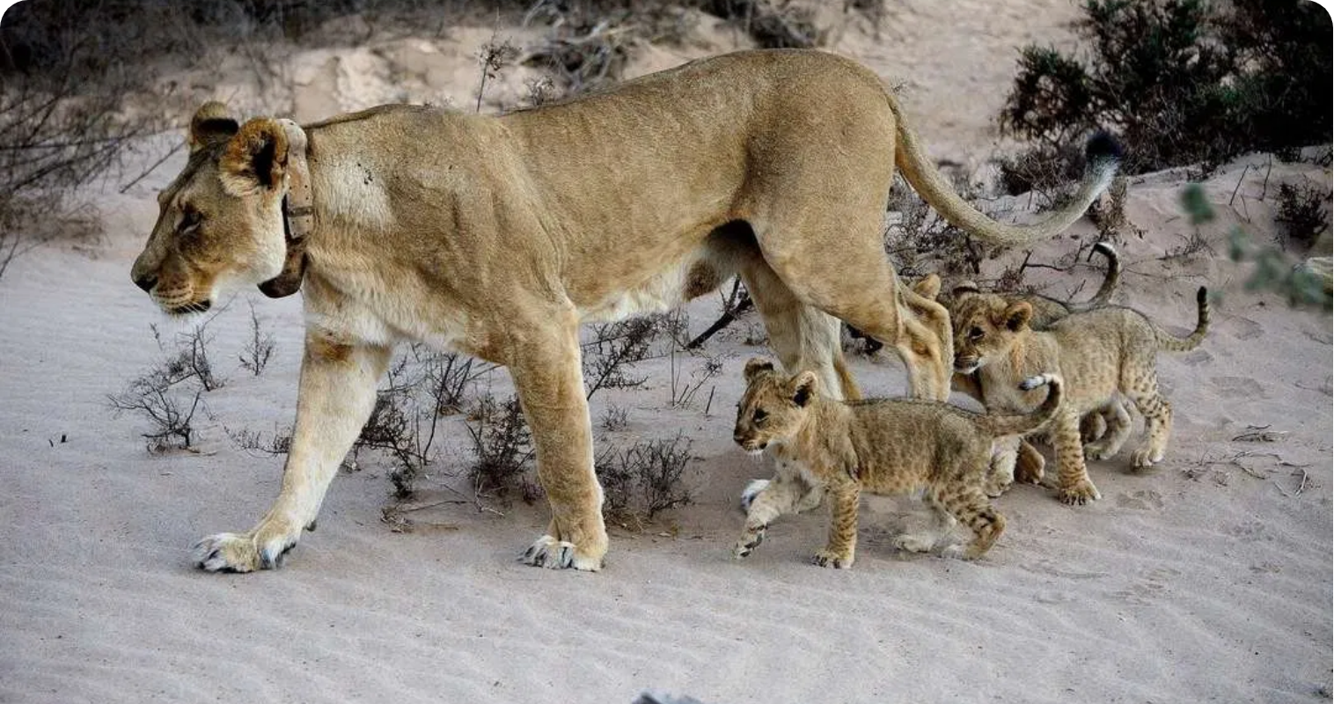
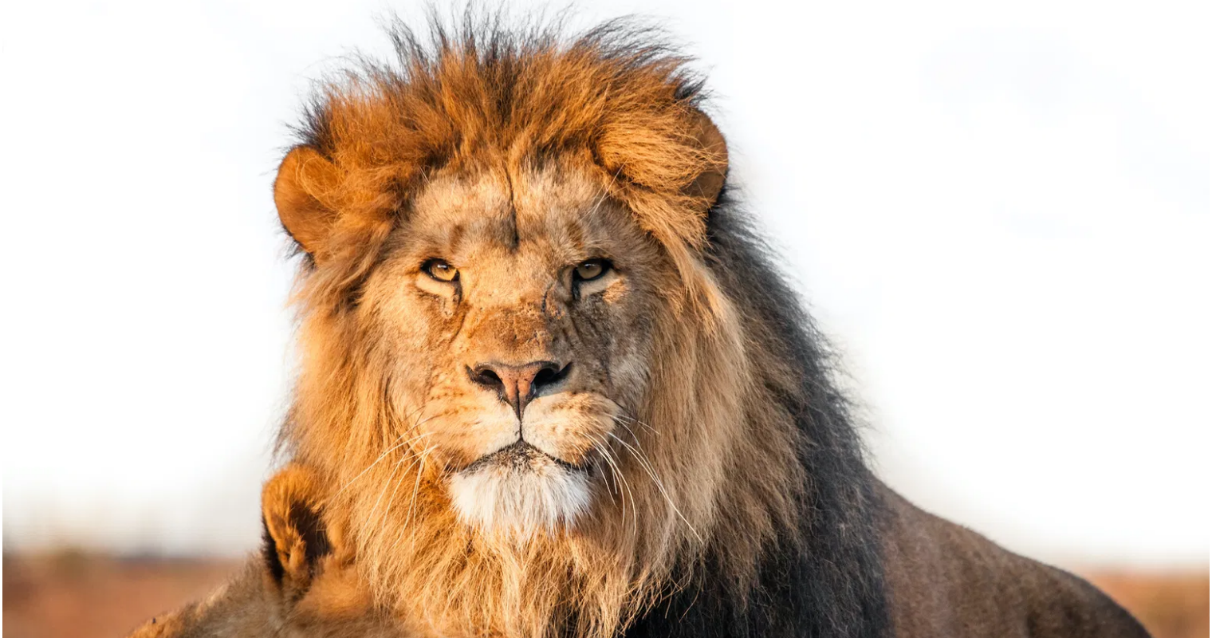
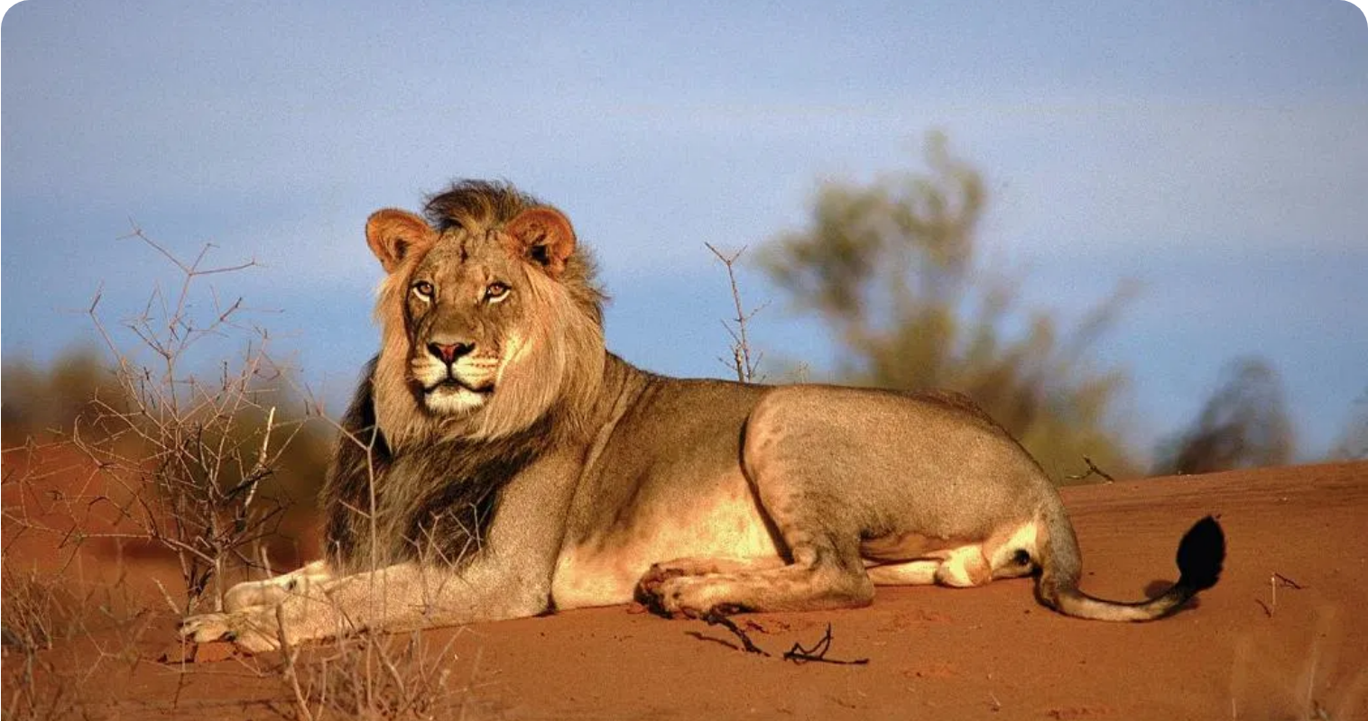
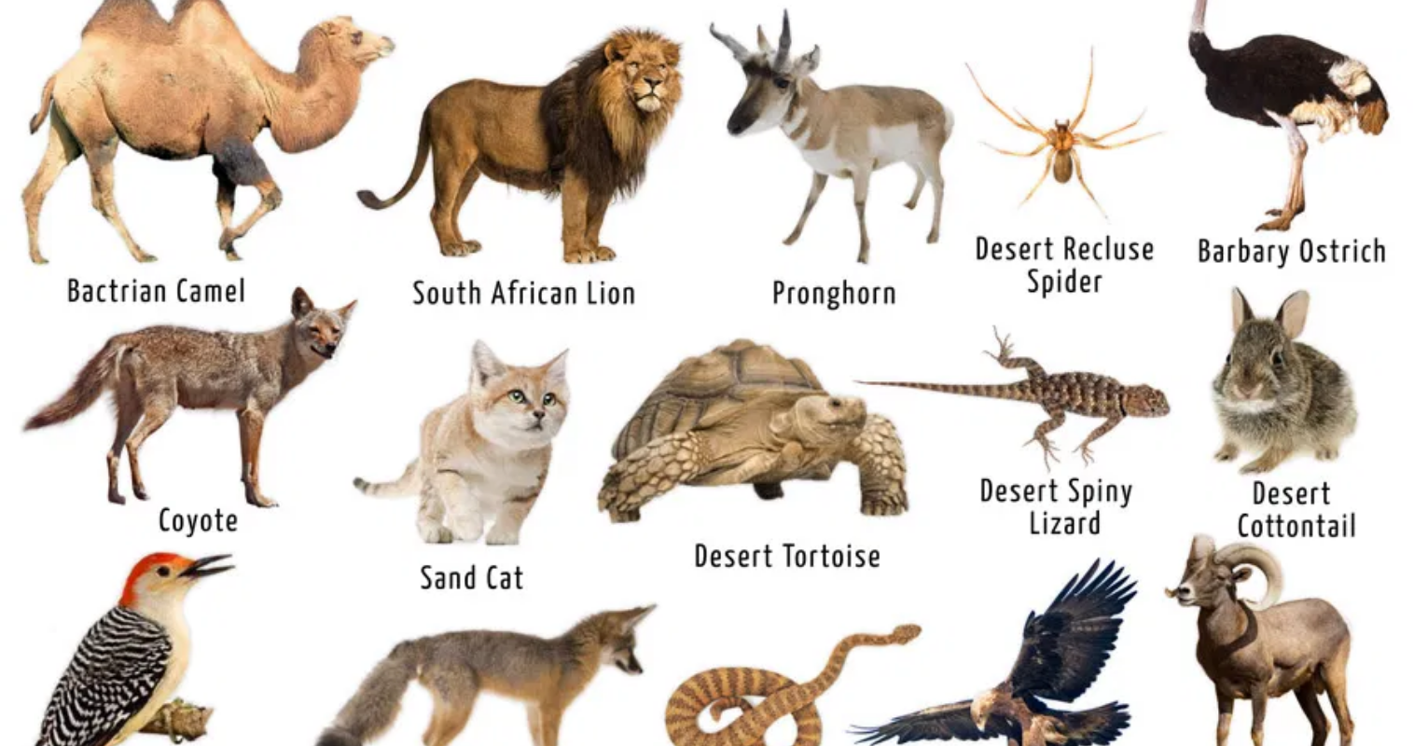
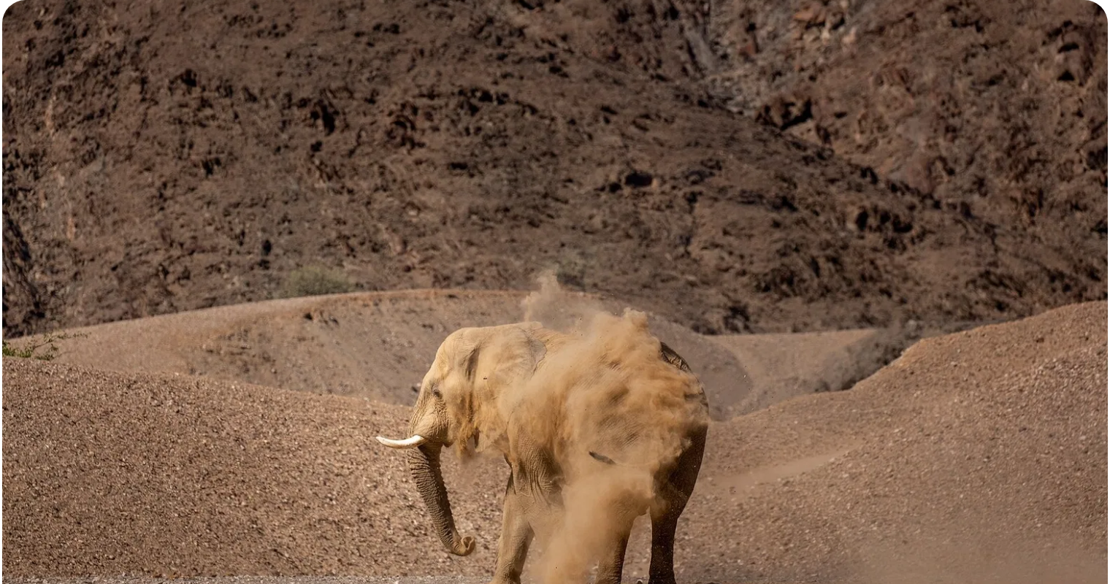
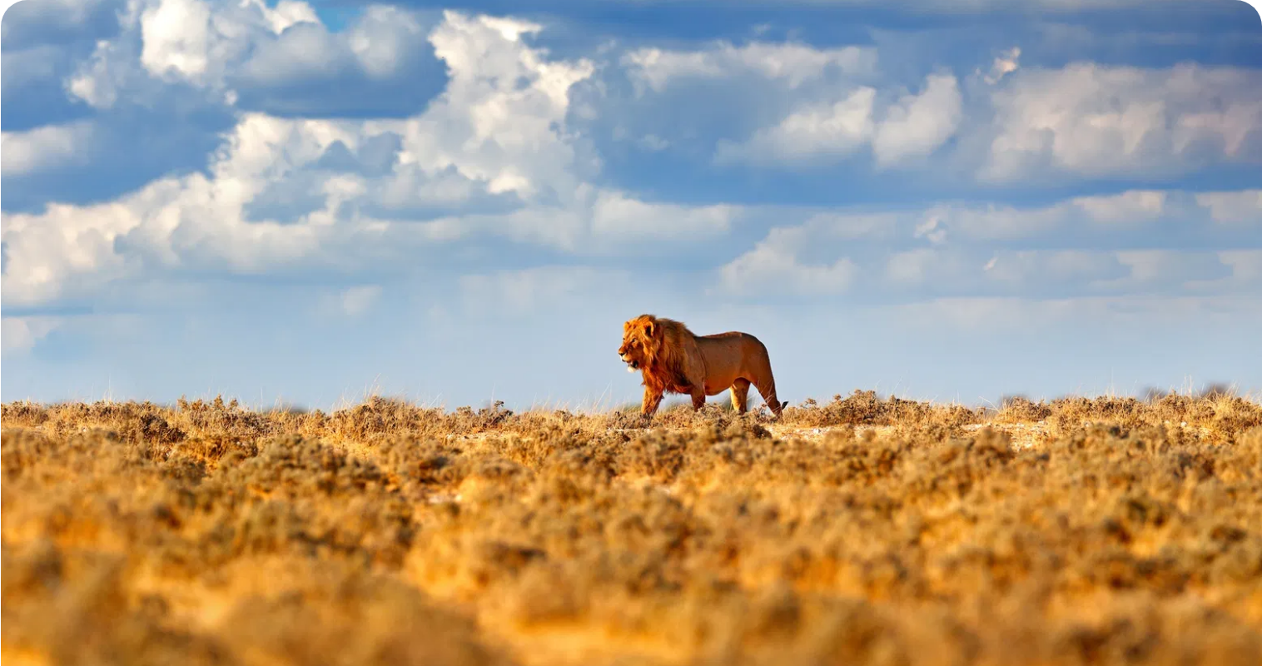
Desert Wildlife Adaptations
Desert Elephants
Desert Lions
Oryx
Leaner bodies than savanna elephants
Leaner with longer legs for sand travel
Can raise body temperature to reduce water loss
Larger feet to walk on soft sand
Thicker coats to withstand cold nights
Long, straight horns act as radiators
Can go several days without water
Survive with less water than savanna lions
White coat reflects sunlight
Know where to dig for water in dry riverbeds
Critically endangered status
Can detect rainfall from great distances
Fennec Foxes
Namib Beetles
Desert Reptiles
Enormous ears dissipate heat
Collect water from fog with body ridges
"Sidewinding" movement on hot sand
Nocturnal to avoid daytime heat
Hydrophilic bumps attract water molecules
Scales reduce water loss
Kidneys conserve water efficiently
Water droplets run down to mouth
Burrow to escape extreme temperatures
Fur-lined feet protect from hot sand
Inspired biomimetic water collection designs
Can survive on minimal water intake

Slide 8
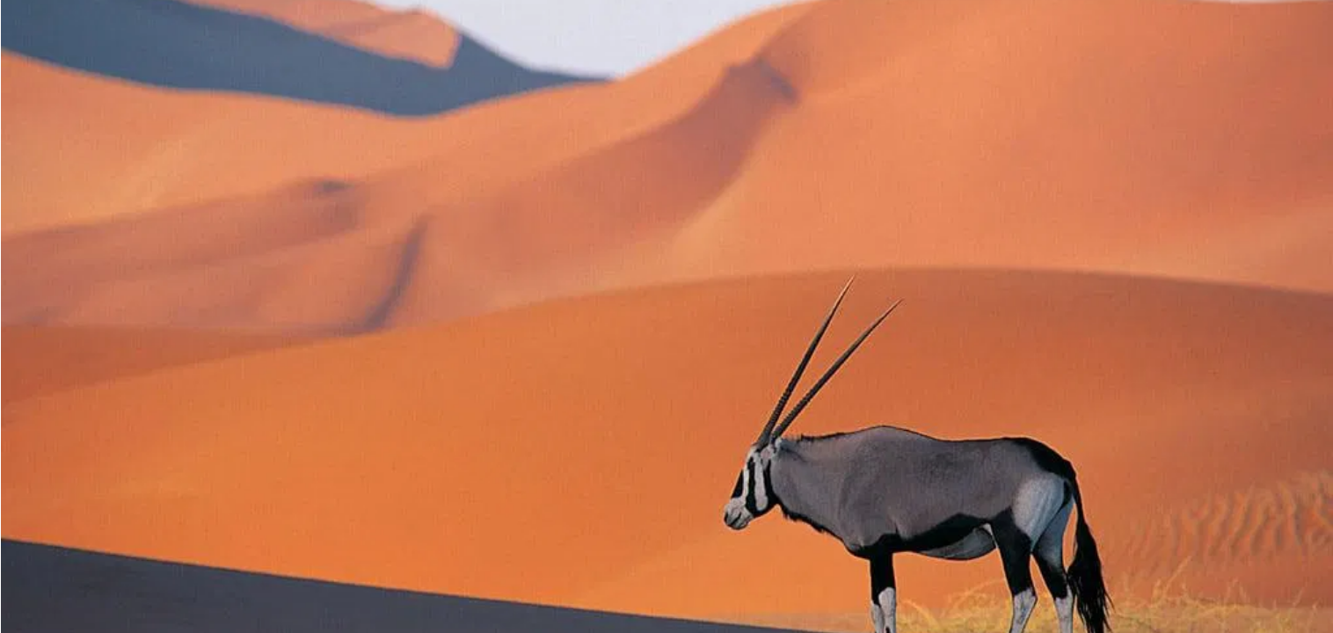
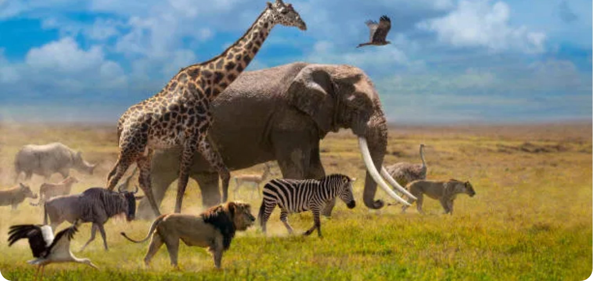
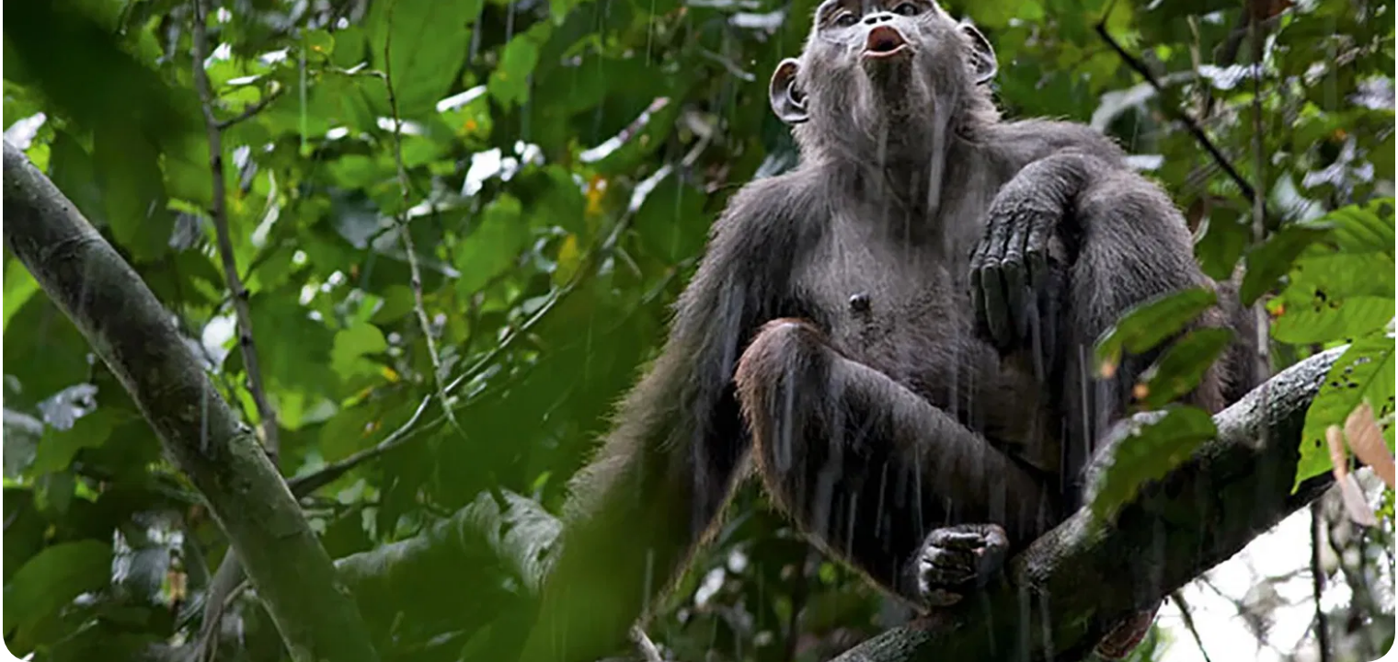
Comparative Wildlife Adaptations
Savanna Adaptations
Rainforest Adaptations
Desert Adaptations
Water Conservation:
Efficient kidneys, drought tolerance, migration to water sources
Arboreal Living:
Prehensile tails, opposable digits, brachiating arms
Extreme Water Conservation:
Concentrated urine, water storage, moisture extraction
Heat Management:
Seeking shade, early morning/evening activity
Moisture Management:
Water-repellent fur/feathers, elevated nests
Thermal Regulation:
Nocturnal activity, burrowing, reflective coloration
Predator Avoidance:
Herding behavior, camouflage, speed
Foraging:
Specialized diets, tool use, cooperative hunting
Sand Navigation:
Specialized feet, sidewinding movement
Food Strategies:
Specialized grazing/browsing, height adaptations
Communication:
Complex vocalizations, visual displays
Dormancy:
Aestivation during extreme conditions
Evolutionary Convergence vs. Divergence
Convergent Evolution
Divergent Evolution
Different species develop similar traits independently in response to similar environmental challenges. Example: Desert adaptations for water conservation appear in unrelated species across African deserts.
Related species develop different traits as they adapt to different environments. Example: African elephants have diverged into savanna and forest subspecies with distinct adaptations.

Slide 9
Conservation Challenges
Habitat Loss & Fragmentation
Poaching & Wildlife Trafficking
Conversion of natural habitats to agriculture, urban development, and resource extraction is the leading threat to African wildlife.
Illegal hunting and trade in wildlife products threatens numerous species across Africa.
Elephant populations declined by 30% between 2007-2014 due to ivory poaching
Africa loses approximately 3.9 million hectares of forest annually
Rhino horn and pangolin scales drive illegal wildlife trade
Fragmentation isolates populations and disrupts migration routes
Bushmeat hunting depletes wildlife in many regions
Human-wildlife conflict increases as habitats shrink
Climate Change
Conservation Success Stories
Shifting climate patterns are altering habitats and challenging wildlife adaptations.
Despite challenges, conservation efforts have achieved important successes.
Increased drought frequency threatens water-dependent species
Mountain gorilla populations have increased from 620 to 1,063 since 1989
Changing rainfall patterns disrupt migration timing
Black rhino numbers have doubled since their low point in the 1990s
Rising temperatures affect breeding cycles and sex ratios
Community conservation models have reduced poaching in many areas
Conservation Approaches
Protected Areas
Community-Based Conservation
International Cooperation
National parks, reserves, and wildlife corridors provide safe havens for wildlife and preserve critical habitats. Africa has over 7,800 protected areas covering about 14% of the continent.
Involving local communities in wildlife management and creating economic incentives for conservation has proven effective in many regions of Africa.
Cross-border conservation initiatives, wildlife trade regulations (CITES), and global funding mechanisms support African wildlife protection efforts.

Slide 10
Conclusion
Africa's Extraordinary Wildlife Legacy
Africa's diverse ecosystems support an extraordinary variety of wildlife, each adapted to thrive in their unique environments:
Savanna
Rainforest
Desert
Home to iconic large mammals and spectacular migrations
Biodiversity hotspot and crucial carbon sink
Showcasing nature's most remarkable adaptations
The interconnectedness of these ecosystems highlights the delicate balance of nature. Changes in one ecosystem can have cascading effects throughout the continent.
While African wildlife faces significant threats from habitat loss, poaching, and climate change, conservation success stories demonstrate that dedicated efforts can make a difference.
How You Can Help
Support reputable conservation organizations working in Africa
Choose sustainable and eco-friendly products
Spread awareness about the importance of African wildlife conservation
If visiting Africa, participate in responsible ecotourism
By protecting Africa's wildlife, we preserve not just individual species, but the extraordinary tapestry of life that makes our planet unique.

