Slide 1
The Rich Tapestry of African Wildlife
Exploring Iconic Species, Ecosystems, and Conservation Challenges

Slide 2
The Diversity of African Wildlife
Majestic Lions
Gentle Giants
Colorful Flamingos
Lions are known as the kings of the jungle due to their powerful presence. They live in prides, showcasing complex social structures.
Elephants are the largest land mammals and are known for their intelligence. They play a crucial role in their ecosystems by shaping the landscape.
Flamingos are famous for their striking pink color, which comes from their diet. They are social birds that often gather in large flocks.
Cunning Crocodiles
Diverse Insects
Crocodiles are skilled hunters, using their stealth to ambush prey. They have adapted to both freshwater and saltwater environments.
Africa is home to a vast array of insects, each playing a vital role in the ecosystem. From pollinators to decomposers, they contribute to the balance of nature.
2
The Rich Tapestry of African Wildlife

Slide 3
Wildlife is the soul of our culture.
Cultural Soul
Wildlife is essential to our cultural identity.
3
The Rich Tapestry of African Wildlife

Slide 4
Challenges Facing African Wildlife
Poaching
Human-Wildlife Conflict
Poaching threatens the survival of many species.
Human expansion increases conflicts with wildlife.
02
04
Habitat Loss
Climate Change
01
Habitat loss reduces wildlife populations.
03
Climate change alters habitats and food availability.
4
The Rich Tapestry of African Wildlife

Slide 5
Conservation Efforts and Success Stories
National Parks
Anti-Poaching
Community Programs
National parks serve as protected areas for wildlife and natural habitats.
They play a crucial role in conservation by providing safe spaces for various species.
Anti-poaching initiatives have significantly reduced illegal hunting activities.
These measures help protect endangered species and maintain biodiversity.
Community-based programs engage local populations in conservation efforts.
They promote sustainable practices that benefit both wildlife and communities.
International Collaborations
Species Recovery
Global partnerships enhance conservation efforts through shared resources and knowledge.
Collaborative projects have led to successful wildlife protection initiatives across borders.
Success stories include the recovery of species like the American bison and the gray wolf.
These efforts demonstrate the effectiveness of targeted conservation strategies.
5
The Rich Tapestry of African Wildlife

Slide 6
Savanna Ecosystems: The Heart of African Wildlife
Savanna Climate
Fire's Role
Savanna ecosystems feature a warm climate with distinct wet and dry seasons.
This environment supports diverse vegetation and iconic wildlife like lions and elephants.
Fire is vital for maintaining savanna ecosystems by promoting new plant growth.
It also helps manage the spread of woody plants, while human activities can disrupt this balance.
6
The Rich Tapestry of African Wildlife

Slide 7
Forests of Africa: Biodiversity Hotspots
Congo Basin
The Congo Basin is the second-largest rainforest in the world.
Biodiversity Richness
The Congo Basin is home to over 10,000 species of tropical plants.
Key Species
Notable species include the African forest elephant.
Carbon Storage
The forests of the Congo Basin store approximately 8% of the world's carbon.
Climate Regulation
These forests help regulate local and global climates.
7
The Rich Tapestry of African Wildlife

Slide 8
Wetlands: Africa's Vital Water Ecosystems
Okavango Delta
Lake Victoria
The Okavango Delta is one of the largest inland deltas in the world.
It supports a rich diversity of wildlife and is crucial for migratory birds.
Lake Victoria is the largest lake in Africa.
It provides essential resources like fish and water for local communities.
Aquatic Biodiversity
Community Impact
Africa's wetlands are home to a wide variety of aquatic species.
They play a key role in maintaining ecological balance.
Wetlands are vital for the livelihoods of many local communities.
They offer resources and opportunities for sustainable development.
8
The Rich Tapestry of African Wildlife

Slide 9
Timeline of Ecosystem Changes in Africa
Ancient Climates
Ancient climates in Africa shaped the continent's diverse ecosystems.
Deforestation Impact
Deforestation causes habitat loss and declines in species populations.
Modern Challenges
Modern challenges threaten the sustainability of Africa's ecosystems.
1
2
3
4
5
Ecosystem Evolution
Ecosystems evolved in response to climatic changes over millennia.
Climate Change Effects
Climate change disrupts weather patterns and destabilizes ecosystems.
9
The Rich Tapestry of African Wildlife

Slide 10
The future will be shaped by how we care for our ecosystems today.
Jane Goodall
This quote highlights the critical role of ecosystems in our future.
It emphasizes the responsibility we have to protect our natural world.
10
The Rich Tapestry of African Wildlife

Slide 11
Summary: Key Takeaways on African Habitats
Habitat Diversity
Ecological Roles
Conservation Challenges
Africa is home to a wide range of habitats, including savannas, forests, deserts, and wetlands.
This diversity supports a vast array of wildlife and plant species.
Different habitats play crucial roles in maintaining ecological balance.
They provide essential services such as carbon storage, water filtration, and soil fertility.
African habitats face significant threats from deforestation, climate change, and urbanization.
These challenges lead to habitat loss and fragmentation, endangering many species.
Biodiversity Importance
Sustainable Practices
Biodiversity in African habitats is vital for ecosystem resilience and human well-being.
It contributes to food security, medicine, and cultural identity.
Implementing sustainable land-use practices can help protect these habitats.
Community involvement and education are key to successful conservation efforts.
11
The Rich Tapestry of African Wildlife

Slide 12
The Big Five: Africa's Most Iconic Animals
Majestic Predators
The Big Five includes the lion, leopard, elephant, rhinoceros, and buffalo.
These iconic animals play crucial roles in Africa's ecosystems.
Conservation Challenges
These species face threats like habitat loss and poaching.
Conservation efforts are essential for their survival.
12
The Rich Tapestry of African Wildlife

Slide 13
Predators of the African Savannah
Lions' Dominance
Lions are apex predators that hunt in groups called prides.
Cheetah Speed
Cheetahs are the fastest land animals, reaching speeds up to 60 mph.
Hyena Pack Tactics
Hyenas hunt in packs and are known for their scavenging abilities.
Wild Dog Coordination
African wild dogs are highly social and excel in coordinated pack hunting.
13
The Rich Tapestry of African Wildlife

Slide 14
African elephants are a keystone species, vital for maintaining the health of their ecosystems.
Ecosystem Engineers
They create waterholes that benefit many other species.
14
The Rich Tapestry of African Wildlife

Slide 15
Timeline of African Wildlife Conservation
Early Protection
The first wildlife reserves in Africa were established in the late 19th century.
Conservation Successes
The African elephant population began to recover in the 1990s due to conservation efforts.
Modern Initiatives
Technology like drones and GPS is now used to monitor and protect wildlife.
1
2
3
4
5
Legislation Milestones
CITES was adopted in 1973 to regulate international trade in endangered species.
Community Involvement
Local communities became integral to wildlife conservation initiatives in the 2000s.
15
The Rich Tapestry of African Wildlife

Slide 16
Summary: Celebrating Africa's Iconic Species
Ecological Significance
Conservation Imperatives
Africa's iconic species play crucial roles in maintaining ecosystem balance.
They contribute to biodiversity, which is essential for ecosystem resilience.
Conservation efforts are vital to protect these species from extinction.
Sustainable practices and habitat preservation are key to ensuring their survival.
16
The Rich Tapestry of African Wildlife

Slide 17
Impact of Poaching on African Wildlife
Species Decline
Illegal Trade
Conservation Efforts
Poaching has drastically reduced populations of elephants and rhinos.
These species are at risk of extinction due to illegal hunting.
The illegal wildlife trade drives poaching and harms biodiversity.
Criminals profit from selling endangered species and their parts.
Efforts to combat poaching include stricter laws and community education.
Protecting wildlife requires collaboration between governments and local communities.
17
The Rich Tapestry of African Wildlife

Slide 18
Habitat Loss and Its Consequences
Deforestation Drivers
Deforestation is driven by logging and land conversion for agriculture.
Agricultural Expansion
Agricultural expansion destroys habitats.
Urbanization Effects
Urbanization causes habitat loss through infrastructure development.
Biodiversity Impact
Habitat loss threatens biodiversity and leads to species extinction.
Wildlife Migration
Habitat loss disrupts wildlife migration patterns.
18
The Rich Tapestry of African Wildlife

Slide 19
Climate Change and African Ecosystems
Changing Rainfall Patterns
Wildlife Adaptation Challenges
Rainfall patterns have become more erratic, affecting agricultural productivity.
Wildlife faces difficulties adapting to rapid environmental changes.
02
04
Rising Temperatures
Increased Frequency of Droughts
01
Average temperatures in Africa have significantly increased, impacting local ecosystems.
03
Droughts are occurring more often, leading to water scarcity.
19
The Rich Tapestry of African Wildlife

Slide 20
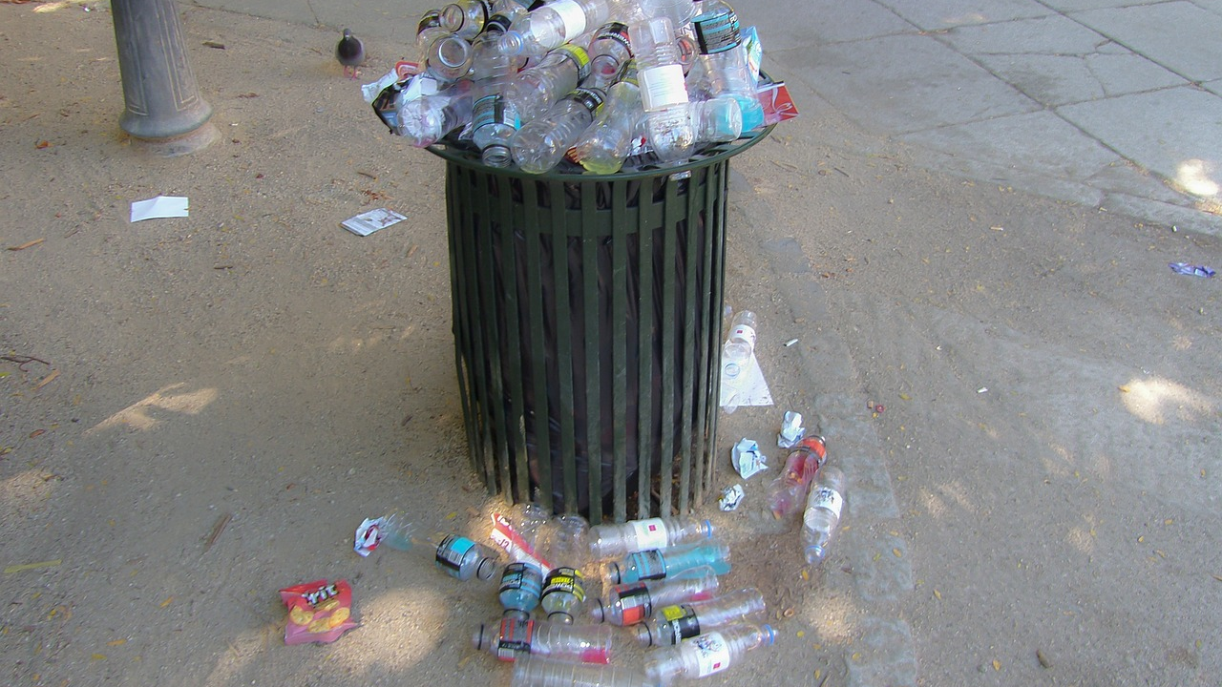
Community Involvement in Conservation
Sustainable Practices
Education Initiatives
Local communities play a crucial role in implementing sustainable practices that protect natural resources.
These practices include waste reduction, habitat restoration, and sustainable agriculture.
Education programs empower communities to understand the importance of conservation.
By partnering with local organizations, these initiatives foster a culture of environmental stewardship.
20
The Rich Tapestry of African Wildlife

Slide 21
Innovative technology is the key to unlocking conservation success.
Tech for Conservation
Technology enhances conservation.
21
The Rich Tapestry of African Wildlife

Slide 22
Key Takeaways on Conservation Challenges
Poaching Threats
Habitat Loss
Climate Impact
Poaching remains a significant threat to wildlife populations worldwide.
Stronger enforcement and community awareness are essential to combat this issue.
Habitat destruction due to urbanization and agriculture is accelerating species decline.
Conservation efforts must prioritize habitat preservation and restoration.
Climate change poses a severe risk to biodiversity and ecosystems.
Mitigation strategies are crucial to protect vulnerable species from its effects.
Community Engagement
Innovative Solutions
Involving local communities in conservation efforts leads to more sustainable outcomes.
Education and economic incentives can foster a sense of stewardship for natural resources.
Technological advancements offer new tools for monitoring and protecting wildlife.
Collaborative approaches can enhance the effectiveness of conservation initiatives.
22
The Rich Tapestry of African Wildlife

Slide 23
Community-Led Conservation Programs
Community Conservancies
Local Benefits
Community conservancies empower local people to manage wildlife resources. They are essential for protecting biodiversity and promoting sustainable practices.
Sustainable tourism initiatives provide economic opportunities for local communities. This leads to job creation and improved livelihoods for residents.
Conservation Challenges
Active Participation
Community-led conservation faces significant challenges, including poaching and land degradation. These issues threaten both wildlife and the benefits that communities derive from conservation efforts.
Engaging local communities is crucial for the success of conservation programs. Their involvement fosters a sense of ownership and commitment to protecting wildlife.
23
The Rich Tapestry of African Wildlife

Slide 24
Technological Innovations in Wildlife Protection
Drones in Conservation
Drones monitor wildlife populations effectively.
GPS Tracking Systems
GPS systems enable precise monitoring of animal locations.
AI Monitoring Tools
AI tools analyze data to detect anomalies.
Anti-Poaching Technologies
Thermal imaging and automated alerts are crucial for anti-poaching efforts.
Effectiveness and Limitations
Technology enhances conservation efforts but has limitations.
24
The Rich Tapestry of African Wildlife

Slide 25
Milestones in African Wildlife Conservation
Landmark Policies
Collaborative Efforts
The Convention on Biological Diversity was adopted in 1992.
The Great Green Wall initiative was launched in 2015.
02
04
Early Initiatives
Conservation Projects
01
The first wildlife reserves were established in the early 20th century.
03
The African Elephant Conservation Act was enacted in 2010.
25
The Rich Tapestry of African Wildlife

Slide 26
Challenges and Solutions in Conservation Strategies
1
2
3
Habitat Loss
Climate Impact
Funding Gaps
Habitat loss threatens wildlife due to urban expansion and intensive agriculture.
Deforestation for timber and land conversion significantly reduces natural habitats.
Climate change disrupts ecosystems and threatens species survival.
Extreme weather events and rising temperatures further exacerbate habitat degradation.
Insufficient funding limits the scope of conservation projects and research initiatives.
Many organizations face challenges in securing the necessary financial resources for effective action.
4
5
Successful Strategies
Actionable Solutions
Community-led conservation efforts have shown success in various regions.
Engaging local populations fosters a sense of ownership and promotes sustainable practices.
Establishing protected areas is crucial for safeguarding critical habitats.
Implementing sustainable agricultural practices can significantly reduce habitat loss.
26
The Rich Tapestry of African Wildlife

Slide 27
Key Takeaways from Conservation Efforts
Impactful Strategies
Lessons Learned
Community-based conservation has proven effective in engaging local populations.
Innovative funding mechanisms, such as eco-tourism, have supported wildlife protection.
Collaboration among stakeholders is crucial for successful conservation efforts.
Adaptive management practices help address changing environmental conditions.
Future Directions
Conservation Challenges
Investing in technology, such as drones and camera traps, can enhance monitoring efforts.
Strengthening legal frameworks will improve enforcement against poaching.
Habitat loss due to agriculture and urbanization remains a significant threat.
Climate change poses new risks to wildlife and their ecosystems.
27
The Rich Tapestry of African Wildlife

