Slide 1
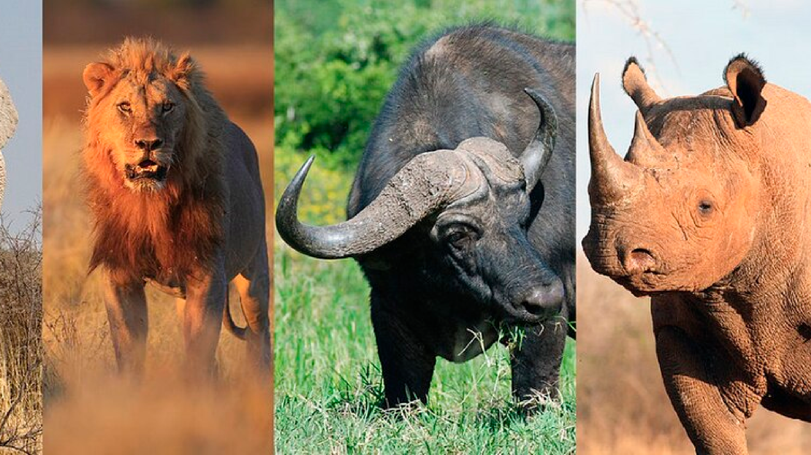
Wildlife in Africa
Exploring the Magnificent Animals of the African Continent
From the legendary Big Five to endangered species, discover the incredible diversity and beauty of Africa's wildlife
NATIONAL GEOGRAPHIC STYLE PRESENTATION

Slide 2
The Big Five
Africa's Most Iconic and Challenging Animals to Encounter
Originally named by big game hunters
for being the most difficult to hunt on foot
Now sought after by photographers
and wildlife enthusiasts worldwide
Conservation Priority
protecting these magnificent species

Slide 3
African Wildlife Habitats
Diverse Ecosystems Supporting Extraordinary Biodiversity
SAVANNA
FORESTS
Grasslands & Plains
Open grasslands with scattered trees, supporting the largest concentrations of wildlife
Tropical Rainforests
Dense, multilayered forests with incredible biodiversity and primate populations
Key Animals:
Gorillas Chimpanzees Forest Elephants Leopards Okapis
Climate: High humidity, constant rainfall, warm temperatures
Key Animals:
Lions Zebras Giraffes Wildebeest Cheetahs
Climate: Hot, dry seasons with brief wet periods
Bongos
Gazelles
WETLANDS
DESERTS
Rivers & Deltas
Water-rich environments supporting aquatic life and water-dependent species
Arid Landscapes
Harsh, dry environments where wildlife has adapted to extreme conditions
Key Animals:
Hippos Crocodiles Sitatunga Manatees Water Buffalo
Climate: Seasonal flooding, permanent water sources
Key Animals:
Flamingos
Desert Elephants Oryx Fennec Fox Addax
Climate: Extreme temperatures, minimal rainfall
Camels
Meerkats
54 Countries
1,100+ Mammal Species
2,600+ Bird Species
Habitat Protection Critical
Made with Genspark

Slide 4
Conservation Challenges
Urgent Action Needed to Protect Africa's Wildlife Heritage
76%
Population Decline
in 50 years
<5,500
Black Rhinos Left
critically endangered
20,000
Lions Remaining
down from 200,000
Poaching
Habitat Loss
Climate Change
Human Conflict
Ivory & horn trade
Agricultural expansion
Rising temperatures
Population growth
High black market value
Urban development
Drought & flooding
Crop raiding
Anti-poaching efforts
Infrastructure projects
Ecosystem shifts
Livestock predation
Conservation Solutions
Protected Areas
National parks & reserves
Community Programs
Local conservation initiatives
Education
Awareness & training
Global Support
International cooperation
Time is Running Out - Act Now!
Made with Genspark

Slide 5
Protecting Our Future
Hope, Action & Conservation Success Stories
Conservation Wins
Mountain Gorillas
Population increased from 620 to 1,000+
Protected Areas
15% of Africa now under protection
Community Programs
Local conservancies thriving
How You Can Help
Donate
Support conservation organizations
Eco-Tourism
Visit responsibly
Spread Awareness
Share & educate others
Leading Conservation Organizations
African Wildlife Foundation
World Wildlife Fund
African Parks
Save the Rhino
Together We Can Make a Difference!
"For Future Generations to Experience Africa's Wonder"
Every action counts. Every voice matters. Every donation helps.
Made with Genspark

